Slide 1
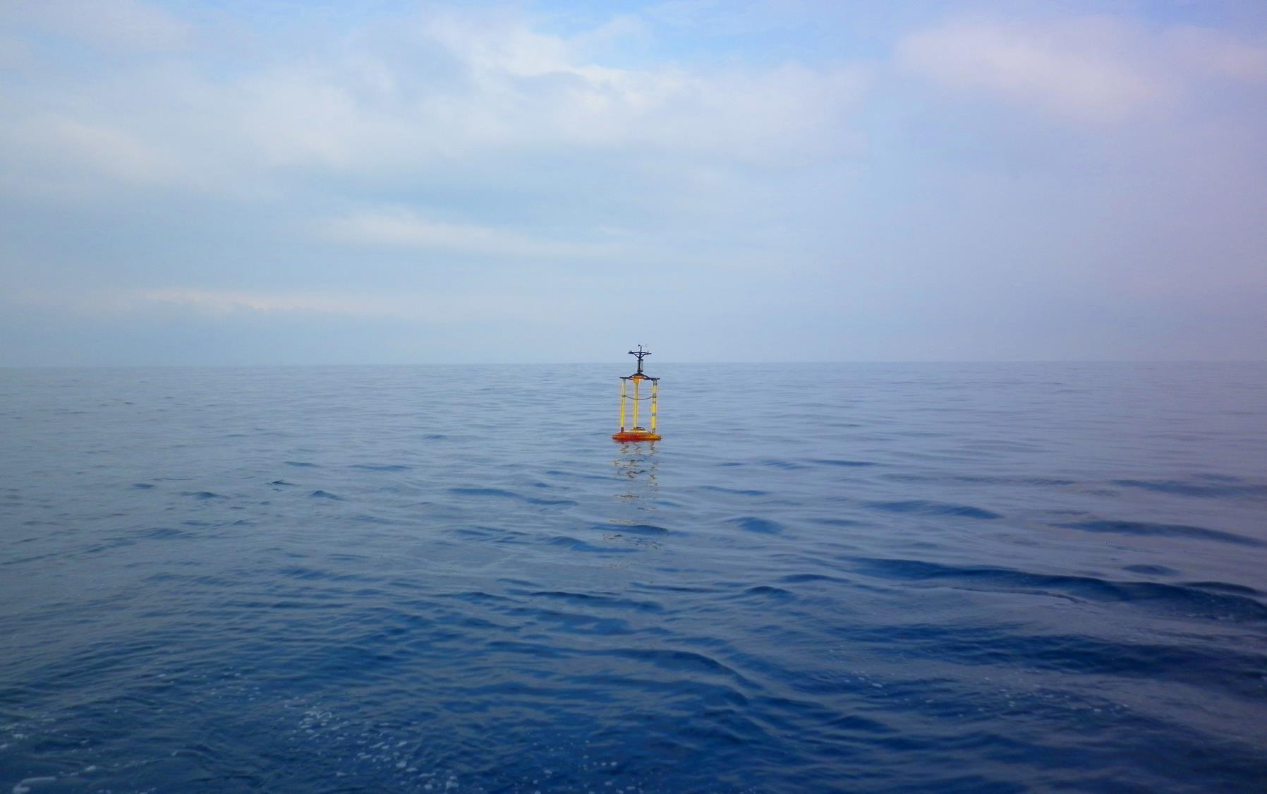





COPERNICUS
MARINE SERVICE
TRAINING WORKSHOP
for Iberia-Biscay-Ireland Region
#CMEMSTraining
May 14-15 2019
Lisbon, Portugal
In Situ Products
Fernando Manzano noLogin / Puertos del Estado (Spain)

Slide 2

“
Without sufficient observations, useful prediction will likely never be possible. Models will evolve and improve, but, without data, will be untestable, and observations not taken today are lost forever
C. Wunsch et al. (2010) PNAS

Slide 3
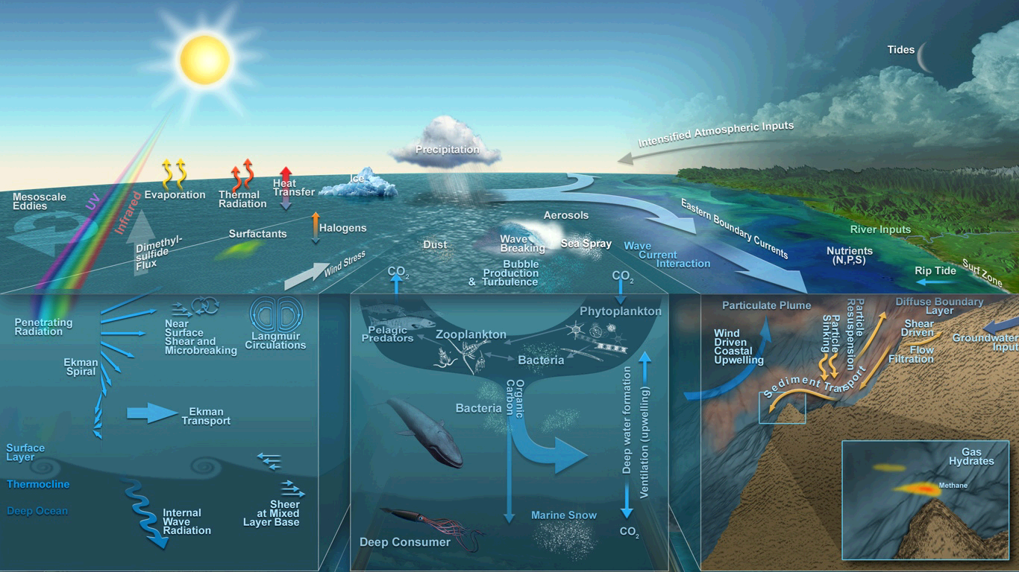
The ocean is complex… …many processes are involved.
In Situ Products
1. In Situ Observations

Slide 4
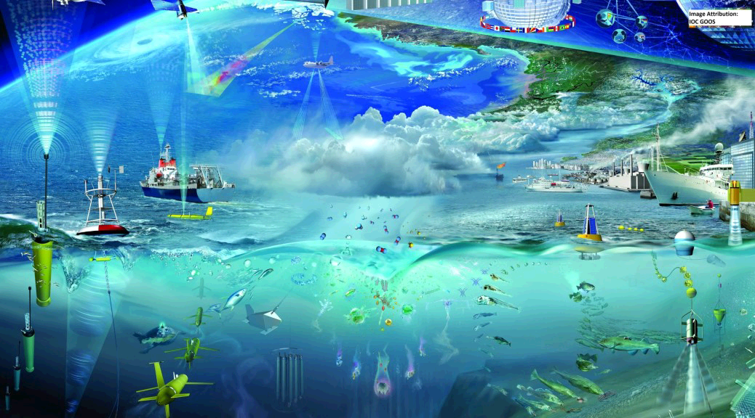
In Situ Products
1. In Situ Observations
A multi-platform approach is essential !

Slide 5
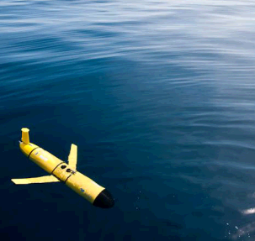
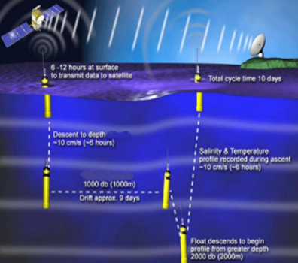
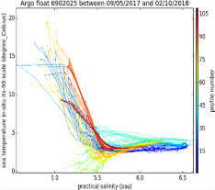
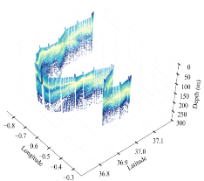
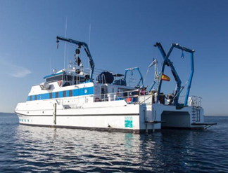
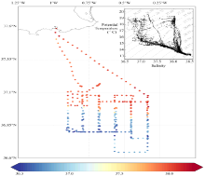
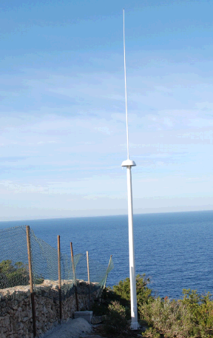
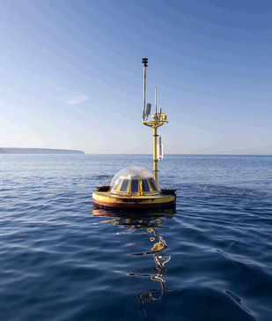
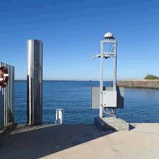
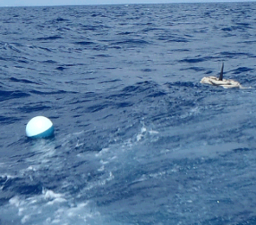
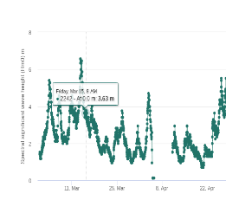
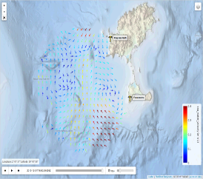
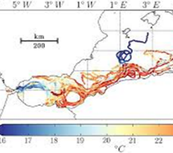
Research vessels
In Situ Products
1. In Situ Observations
ARGO floats
Gliders
Drifting
buoys
HF
radars
Moorings

Slide 6








In Situ Products
2. CMEMS In Situ TAC
The component of the CMEMS which ensures a consistent and reliable access to a range of in situ data for the purpose of service production and validation.
Data producers
7 MFCs (Models)
GLO MFC
ARC MFC
BAL MFC
NWS MFC
IBI MFC
MED MFC
BS MFC
8 TACs (Observations)
In Situ TAC
6 Space TACs:
OCTAC,
SLTAC, …
1 Multi Obs.
http://www.marineinsitu.eu
http://copernicus.eu
3 components:
- Space
- Insitu
- Services
Atmosphere Monitoring
Climate Change
Marine Monitoring (CMEMS)
Land Monitoring
Security
Emergency Management
And many others:
CTD campaigns, Sea mammals, etc.
http://marine.copernicus.eu

Slide 7
In Situ Products
2. CMEMS In Situ TAC Objectives
Two main objectives:
To collect multi-source, multi-platform, heterogenous data, perform consistent quality control and distribute it in a common format (NetCDF) and in near-real-time (within 24 hours) to the CMEMS Marine Forecasting Centres (MFC), for assimilation into their numerical ocean models.
To supply the MFCs and downstream users with re-processed 25-50-year products in delayed mode. In addition to the near-real-time products, these delayed-mode products are useful for model validation or assimilation in ocean reanalysis and climate studies.
And many others:
CTD campaigns, Sea mammals, etc.

Slide 8
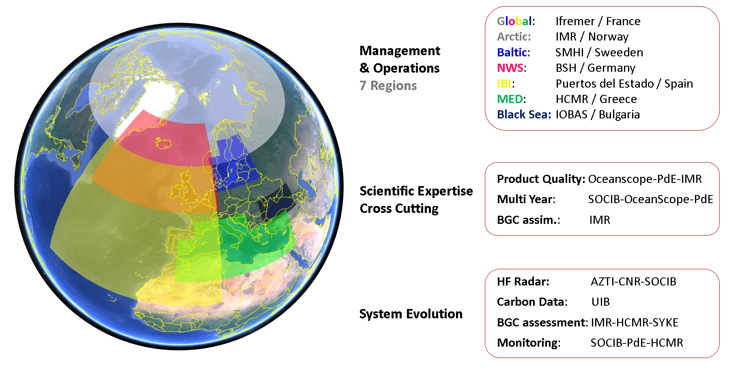
In Situ Products
2. CMEMS In Situ TAC Organization
CMEMS IBI TRAINING WORKSHOP, In Situ Products, 14-15 May, Lisbon, Portugal

Slide 9
In Situ Products
2. CMEMS In Situ TAC General Description
Fully operational service since April 2015
Unique data access to all the available data: CMEMS catalogue (registration)
Open and free data policy
Strong collaboration with EuroGOOS, SeaDataNet and EMODnet
7 Components: Global + 6 regions (Arctic, Baltic, NWS, IBI, MED and Black Sea)
Same data format (NetCDF - OceanSites 1.2)
Same FTP structure in all the regions
Homogenization of variable names, units, attributes
Same RTQC & quality flagging convention
NRT (Near Real Time) and REP (REProcessed) products
CMEMS IBI TRAINING WORKSHOP, In Situ Products, 14-15 May, Lisbon, Portugal

Slide 10















In Situ Products
2. CMEMS In Situ TAC Data Flow
Operations NRT
International Organizations
Real Time
Quality Control
Synchronization with other PUs
(shared providers)
GTS
Automatic
Flagged data
Acquire Data
Not homogeneous
Homogenization NetCDF
Distribute
NRT products
Central
Dissemination Unit
Data Base
Providers
through ROOSes
Service Monitoring
Alerts System
Service Desk Users interaction
Delayed mode REP
Validate Product
Periodic
Scientific assessment
Distribute
REP products
Cross cutting
activities
Management & Documentation
Product Quality
System Evolution
Scientific exploitation
OSR
Web Site
CMEMS IBI TRAINING WORKSHOP, In Situ Products, 14-15 May, Lisbon, Portugal

Slide 11
In Situ Products
2. CMEMS In Situ TAC Numbers
+7000 platforms active in Real Time
+37000 platforms integrated
+300 providers
CMEMS IBI TRAINING WORKSHOP, In Situ Products, 14-15 May, Lisbon, Portugal

Slide 12
In Situ Products
2. CMEMS In Situ TAC Products
NRT (Near Real Time) products (automatic RTQC):
Hourly updates
Distributed in Global & Regional
All variables: T&S, Wave, UV(Currents), BGC, Sea level
HF Radar and Carbon data in April 2019
REProcessed products (validated & assessed):
Twice a year update
Global
Variables:
PUM
Product
User
Manual
Documents
associated with
each product:
QuID
Quality
Information
Document
- T&S since 2015
- UV (currents) from Drifters since 2016
- Waves since 2018
- BGC (O2 and Chla) since 2018
- Carbon data new in 2019
- HF Radar planned for 2020
CMEMS IBI TRAINING WORKSHOP, In Situ Products, 14-15 May, Lisbon, Portugal

Slide 13
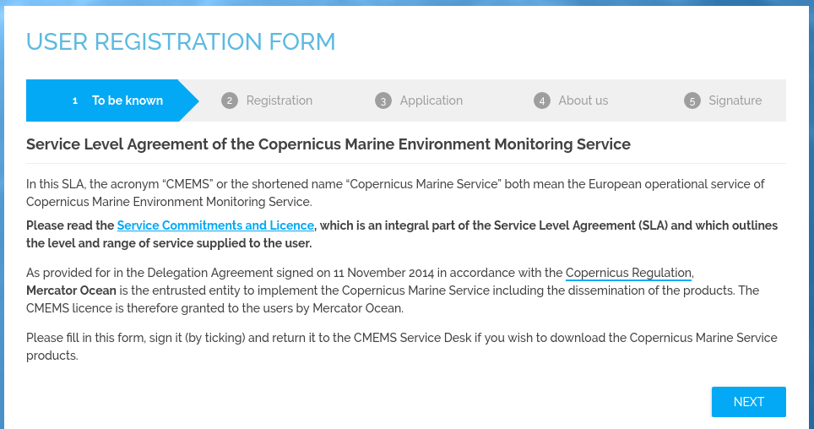
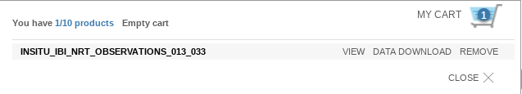
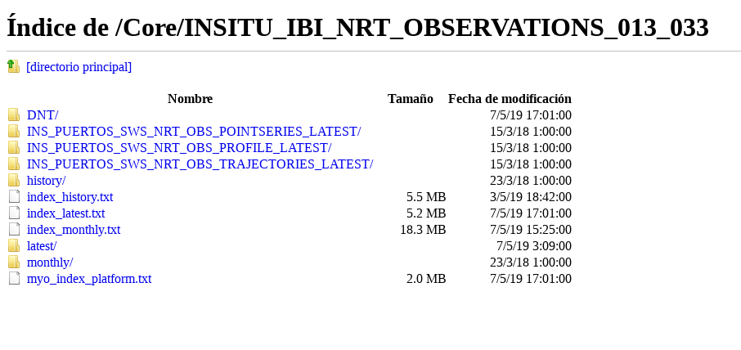
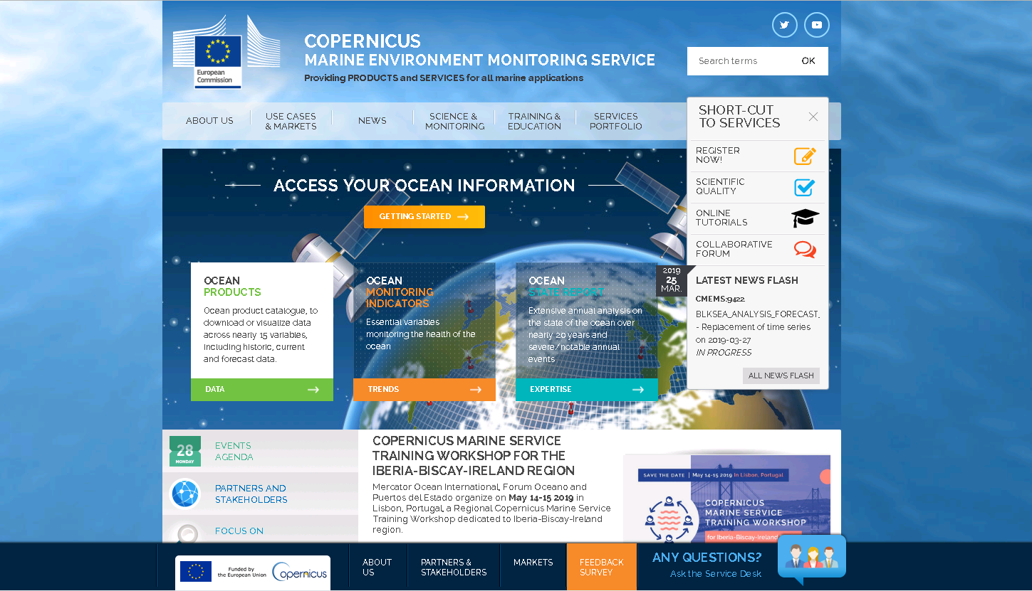
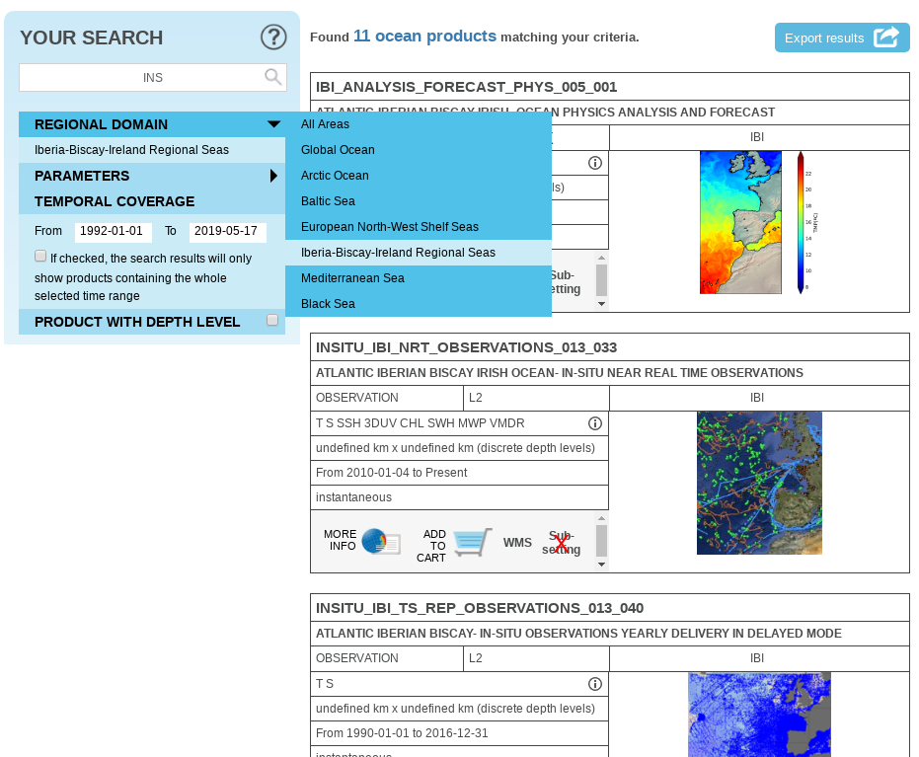

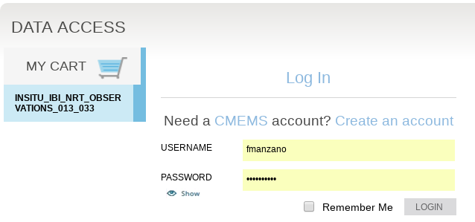
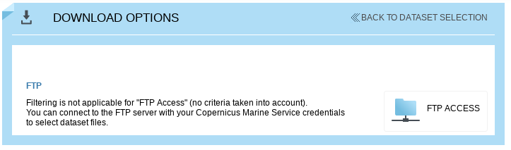
In Situ Products
2. CMEMS In Situ TAC Access
http://marine.copernicus.eu
CMEMS IBI TRAINING WORKSHOP, In Situ Products, 14-15 May, Lisbon, Portugal

Slide 14
In Situ Products
3. CMEMS In Situ TAC IBI region Responsibilities
Roles & responsibilities:
Puertos del Estado: Coordination. NRT production and validation (assigned providers). Waves REP development and assessment.
Ifremer: Contribution to the NRT production and validation for French providers and Lagrangian and underway platforms.
Oceanscope: T&S REP product validation and assessment.
Institute | Coordination | Production Unit PU | Synchronization PUs | Product Quality NRT Assessment | Product Quality multi-year Assessment (REP)
Puertos del Estado | IBI | IBI | GLO, IBI, MED, NWS | IBI | IBI (WAVES)
Ifremer |  |  | IBI | IBI
Oceanscope |  |  |  |  | IBI (T&S)
CMEMS IBI TRAINING WORKSHOP, In Situ Products, 14-15 May, Lisbon, Portugal

Slide 15
In Situ Products
3. CMEMS In Situ TAC IBI region Providers
Fixed stations (Moorings)
Buoys
Tide Gauges,
Platforms,
Lightships,
River flow stations
Spain: Puertos del Estado, IEO, Euskalmet,
Xunta Galicia, SOCIB
Portugal: Instituto Hidrografico,
University of Azores, DGT
France: SHOM, Meteofrance, Ifremer,
CETMEF, CEREMA
Ireland: Marine Institute (buoys & tidegauges)
UK: UKMO, EA (UK tide gauges), CEFAS
Lagrangian and underway stations
Profilers-gliders:
ARGO, CTD, Gliders, XBT and other profiles
Drifters
Vessels
EuroARGO (BSH, IEO, Ifremer, RNMI, UKMO, MI, SHOM, LOV,…)
Data from GTS (Global Telecommunication System)
SeaDataNet (Historical)
European: PLOCAN, Univ. College, SOCIB, IRD Brest, IRISH SHIPPING LTD, SBR, INSU,…
Non European: NOAA, WOODS HOLE O.I., Univ. Washington, US Navy, Inst. Ocean Sciences Victoria,…
CMEMS IBI TRAINING WORKSHOP, In Situ Products, 14-15 May, Lisbon, Portugal

Slide 16



In Situ Products
3. CMEMS In Situ TAC IBI region The IBI Coord. Team
Marta de Alfonso
Management & Product Quality & OSR-OMI
Fernando Manzano
Operations & System Evolution
Alex Gallardo
Operations & Development
CMEMS IBI TRAINING WORKSHOP, In Situ Products, 14-15 May, Lisbon, Portugal

Slide 17

In Situ Products
4. Products Description
Changes are coming!
Transition to NetCDF4
New structure and file naming
…
May 2019
Jun 2019
Sep 2019
NetCDF3 - NetCDF4 files consistency
Start NetCDF4 distribution
Stop NRT NetCDF3
Jul 2019 to Sep 2019 NetCDF3 and NetCDF4 datasets are produced in parallel

Slide 18
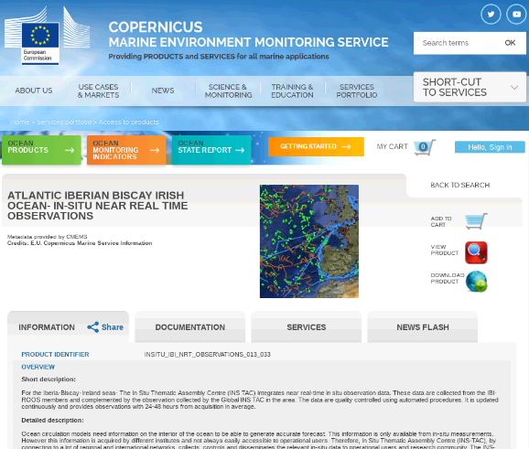
In Situ Products
4. Products Description
NetCDF files are accessed from http://marine.copernicus.eu but at the end it’s only an FTP access:
NRT: ftp://nrt.cmems-du.eu/Core/INSITU_IBI_NRT_OBSERVATIONS_013_033
REP: ftp://my.cmems-du.eu/Core/INSITU_IBI_TS_REP_OBSERVATIONS_013_040/
Index files to smooth the navigation and search
Files organized based on periods:
Latest: Last 30 days of data
Monthly: Last 5 years of data
History: Since ever, whole datasets
CMEMS IBI TRAINING WORKSHOP, In Situ Products, 14-15 May, Lisbon, Portugal

Slide 19










In Situ Products
4. Products Description Folders structure
3 datasets: latest, monthly, history
1 dataset with 3 subfolders
/ibi_multiparameter_nrt
/Core/INSITU_IBI_NRT_OBSERVATIONS_013_033
myo_index_platform.txt
index_latest.txt
/latest
index_monthly.txt
/monthly
index_history.txt
/history
myo_index_platform.txt
/DNT
/PF
/DC
/TS
/PF
/DC
/TS
myo is an old reference to MyOcean project
One directory / day
One file / day / platform
/drifter
/drifter
/XB
/GL
/CT
/XB
/GL
/CT
.nc
/etc
/etc
/ML
*Last 30 days
/MO
/BO
/ML
/MO
/BO
/mooring
/mooring
/RF
/FB
/SM
/RF
/FB
/SM
/profiler-glider
/profiler-glider
Old subfolders were not clear
1 subfolder per data type
/HF
/SF
/XX
/HF
/SF
/XX
/vessel
/vessel
/DB
/TG
/DB
/TG
One directory / month
One file / month / platform
One file / platform
.nc
.nc
*Since ever
*Last 5 years
New NRT product structure, implemented from July 2019
CMEMS IBI TRAINING WORKSHOP, In Situ Products, 14-15 May, Lisbon, Portugal

Slide 20
In Situ Products
4. Products Description Folders structure
/Core/INSITU_IBI_TS_REP_OBSERVATIONS_013_040
index_history.txt
/history
/DNT
/drifter
/etc
/mooring
/profiler-glider
/vessel
One file / platform
.nc
*Since ever
Regional TS REP products will disappear…
CMEMS IBI TRAINING WORKSHOP, In Situ Products, 14-15 May, Lisbon, Portugal

Slide 21


In Situ Products
4. Products Description Folders structure
/Core/INSITU_IBI_NRT_OBSERVATIONS_013_033
/ibi_multiparameter_nrt
index_monthly.txt
/monthly
index_bestdata.txt
/bestdata
index_platform.txt
/DNT
index_latest.txt
/latest
index_history.txt
/history
/TS
/PF
/PF
/TS
/TS
/PF
/DC
/DC
/DC
One directory / day
One file / day / platform
/XB
/GL
/GL
/XB
/XB
/GL
/CT
/CT
/CT
.nc
/ML
/MO
/MO
/ML
/ML
*Last 30 days
/MO
/BO
/BO
/BO
/SM
/RF
/RF
/SM
/SM
/RF
/FB
/FB
/FB
/XX
/HF
/HF
/XX
/XX
/HF
/SF
/SF
/SF
/DB
/DB
/DB
/TG
/TG
/TG
One file / platform
One directory / month
One file / month / platform
One file / platform
.nc
.nc
.nc
*Since ever
*Since ever
*Last 5 years
New NRT product structure, implemented from July 2019
CMEMS IBI TRAINING WORKSHOP, In Situ Products, 14-15 May, Lisbon, Portugal

Slide 22
In Situ Products
4. Products Description Index files
index_latest.txt
# Title : in-situ observations catalog
# Description : catalog of available IBI in-situ observations per platform.
# Project : Copernicus (generated by Puertos del Estado-SPAIN).
# Format version : 1.1.
# Date of update : 20190508093503
# product_id,file_name,geospatial_lat_min,geospatial_lat_max,geospatial_lon_min,geospatial_lon_max,time_coverage_start,time_coverage_end,provider,date_update,data_mode,parameters
COP-IR-01,ftp://arcas.puertos.es/Core/INSITU_IBI_NRT_OBSERVATIONS_013_033/ibi_multiparameter_nrt/latest/20190408/IR_TS_MO_13130_20190408.nc,28.187,28.1987,-15.8032,-15.7977,2019-04-08T00:00:00Z,2019-04-08T23:00:00Z,Puertos del Estado (Spain),2019-04-23T09:33:34Z,R,DEPH TEMP VTM02 VTPK PSAL ATMS VMDR HCSP VHM0 WSPD VPED DRYT HCDT
COP-IR-01,ftp://arcas.puertos.es/Core/INSITU_IBI_N15.8014,2019-04-09T00:00:00ZRT_OBSERVATIONS_013_033/ibi_multiparameter_nrt/latest/20190409/IR_TS_MO_13130_20190409.nc,28.1856,28.1943,-15.805,-,2019-04-09T23:00:00Z,Puertos del Estado (Spain),2019-04-23T09:33:34Z,R,DEPH TEMP VTM02 VTPK PSAL ATMS VMDR HCSP VHM0 WSPD VPED DRYT HCDT
COP-IR-01,ftp://arcas.puertos.es/Core/INSITU_IBI_NRT_OBSERVATIONS_013_033/ibi_multiparameter_nrt/latest/20190410/IR_TS_MO_13130_20190410.nc,28.1856,28.1914,-15.805,-15.8014,2019-04-10T00:00:00Z,2019-04-10T23:00:00Z,Puertos del Estado (Spain),2019-04-23T09:33:34Z,R,DEPH TEMP VTM02 VTPK PSAL ATMS VMDR HCSP VHM0 WSPD VPED DRYT HCDT
COP-IR-01,ftp://arcas.puertos.es/Core/INSITU_IBI_NRT_OBSERVATIONS_013_033/ibi_multiparameter_nrt/latest/20190411/IR_TS_MO_13130_20190411.nc,28.1856,28.1929,-15.805,-15.7996,2019-04-11T00:00:00Z,2019-04-11T23:00:00Z,Puertos del Estado (Spain),2019-04-23T09:33:34Z,R,DEPH TEMP VTM02 VTPK PSAL ATMS VMDR HCSP VHM0 WSPD VPED DRYT HCDT
COP-IR-01,ftp://arcas.puertos.es/Core/INSITU_IBI_NRT_OBSERVATIONS_013_033/ibi_multiparameter_nrt/latest/20190412/IR_TS_MO_13130_20190412.nc,28.187,28.1973,-15.805,-15.7996,2019-04-12T00:00:00Z,2019-04-12T23:00:00Z,Puertos del Estado (Spain),2019-04-23T09:33:34Z,R,DEPH TEMP VTM02 VTPK PSAL ATMS VMDR HCSP VHM0 WSPD VPED DRYT HCDT
index_platform.txt
# Title : in-situ platforms catalog
# Description : catalog of available IBI in-situ platforms.
# Project : Copernicus (generated by Puertos del Estado-SPAIN).
# Format version : 1.0.
# Date of update : 20190508093508
# platform_code,creation_date,update_date,wmo_platform_code,data_source,institution,institution_edmo_code,parameter,last_latitude_observation,last_longitude_observation,last_date_observation
13130,2019-05-08T09:35:07Z,2019-05-08T09:33:52Z,13130,IR_LATEST_MO_13130_13130 IR_XXXXXX_MO_13130_13130,Puertos del Estado (Spain),2751,DEPH VHM0 VTPK VTM02 VMDR VPED ATMS DRYT WSPD HCSP HCDT TEMP PSAL,28.187,-15.805,2019-05-08T09:00:00Z
13131,2019-05-08T09:35:07Z,2019-05-08T09:33:52Z,13131,IR_LATEST_MO_13131_13131 IR_XXXXXX_MO_13131_13131,Puertos del Estado (Spain),2751,DEPH VHM0 VZMX VTPK VTM02 VMDR VPED ATMS WSPD WDIR HCSP HCDT TEMP PSAL,27.9981,-16.5942,2019-05-08T08:00:00Z
61196,2019-05-08T09:35:07Z,2019-05-08T09:33:52Z,61196,IR_LATEST_MO_61196_61196 IR_XXXXXX_MO_61196_61196,Puertos del Estado (Spain),2751,DEPH VHM0 VZMX VTPK VTM02 VMDR VPED ATMS WSPD WDIR,41.8994,3.6517,2019-05-08T09:00:00Z
61197,2019-05-08T09:35:07Z,2019-05-08T09:33:52Z,61197,IR_LATEST_MO_61197_61197 IR_XXXXXX_MO_61197_61197,Puertos del Estado (Spain),2751,DEPH VHM0 VZMX VTPK VTM02 VMDR VPED ATMS DRYT WSPD WDIR,39.7124,4.4281,2019-05-08T09:00:00Z
CMEMS IBI TRAINING WORKSHOP, In Situ Products, 14-15 May, Lisbon, Portugal

Slide 23
In Situ Products
4. Products Description File naming conventions
Latest directory:
• RR_LATEST_XX_YY_CODE_YYYYMMDD.nc
Monthly directory:
• RR_YYYYMM_XX_YY_CODE.nc
History directory:
• RR_XX_YY_CODE_ZZZ.nc
RR: region bigram
LATEST: fixed name
XX: TS (timeserie) or PR (profile)
YY: data type
CODE: platform code
YYYYMMDD: year month day of observations
YYYYMM : year month of observations
ZZZ : To split files (per year, time sampling…)
.nc: NetCDF file name suffix
Data types
PF profiling floats
GL gliders
MO fixed buoys, mooring time series
RF River flow
HF HF radar
DB drifting buoys
DC drifting buoy reporting current
CT oceanographic CTD profiles
BO bottle data
FB ferrybox
SF towed CTD data (ex: scanfish)
TG Tide gauge station
TS thermosalinograph data
XB XBT or XCTD profiles
ML mini logger for fishery observing system
SM Sea mammals data
XX Not yet identified data type
Region bigram
GL Global
AR Arctic
BO Baltic
NO North West Shelf
IR IBI (Iberia-Biscay-Ireland)
MO Mediterranean
BS Black Sea
IR_LATEST_TS_MO_62082_20190409.nc → IR_TS_MO_62082_20190409.nc
IR_201904_TS_MO_MahonTG.nc → IR_TS_TG_MahonTG_201904.nc
IR_TS_MO_Bilbao-coast-buoy.nc → IR_TS_MO_Bilbao-coast-buoy.nc
New NRT product file naming convention is easier
RR_XX_YY_CODE_*.nc
* YYYYMMDD for latest
*YYYYMM for monthly
*ZZZ for history
CMEMS IBI TRAINING WORKSHOP, In Situ Products, 14-15 May, Lisbon, Portugal

Slide 24
In Situ Products
4. Products Description New version
Transition to NetCDF4 classic format
Use of data packaging method based on scale factor an offset
File naming harmonization
Reshape of directories structure:
Only one dataset in NRT product
Regional REP products are now in NRT
New subfolders based on data types
_FillValue attribute set to default value of the variable type NetCDF4
Homogenization of variable names, descriptions and units
CMEMS IBI TRAINING WORKSHOP, In Situ Products, 14-15 May, Lisbon, Portugal

Slide 25
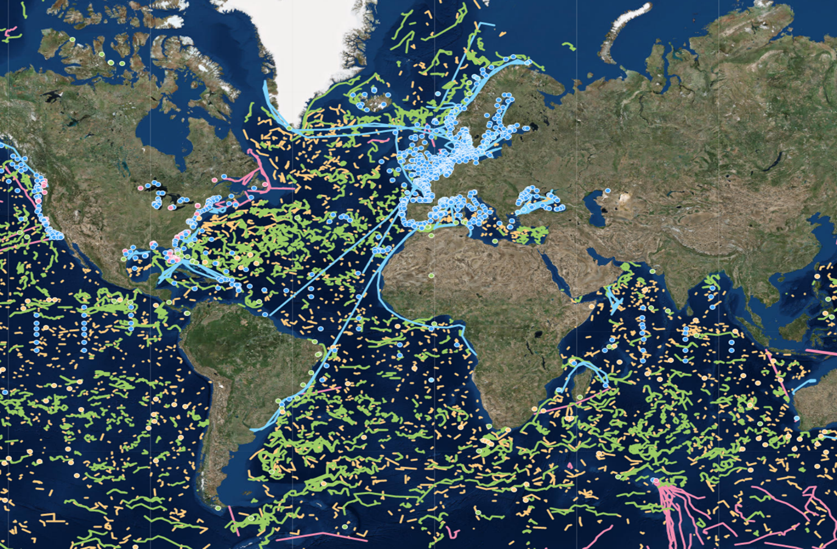
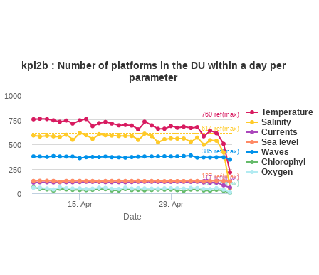
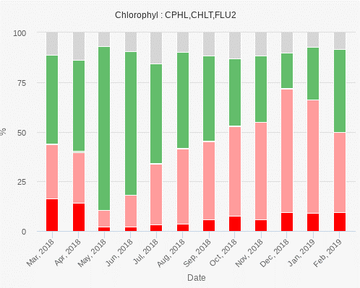
In Situ Products
5. CMEMS In Situ TAC Improvements
Website
Dashboard
Key Performance Indicators

Slide 26
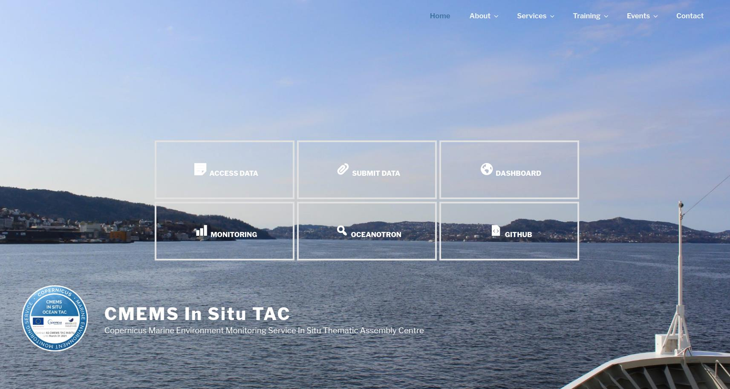
http://www.marineinsitu.eu

Slide 27
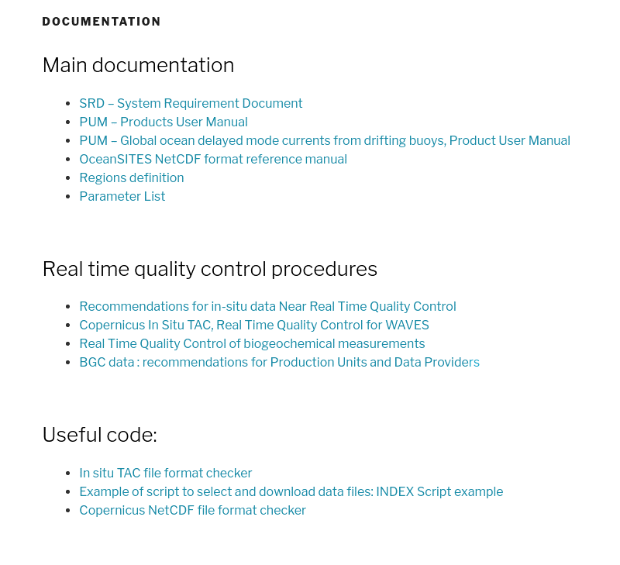
In Situ Products
5. CMEMS In Situ TAC Improvements Website
> About > Documentation
http://www.marineinsitu.eu/documentation/
Documentation
SRD – System Requirement Document
PUM – Products User Manual
OceanSITES NetCDF Format Reference
Parameters List
Quality Control procedures
Some useful code
CMEMS IBI TRAINING WORKSHOP, In Situ Products, 14-15 May, Lisbon, Portugal

Slide 28
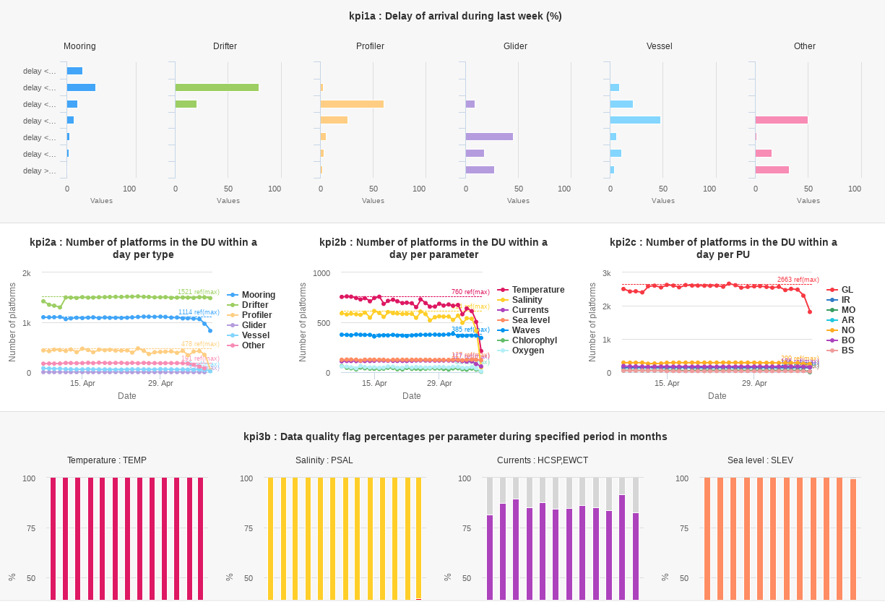
In Situ Products
5. CMEMS In Situ TAC Improvements KPIs
> Services > Monitoring
http://www.marineinsitu.eu/monitoring/
Key Performance Indicators
KPI1 – Delay of Arrival
KPI2 – Number of Platforms
KPI3 – Data Quality
KPI4 – Usage (deprecated)
KPI5 – Data Providers Soon
KPI6 – Data Files Soon
CMEMS IBI TRAINING WORKSHOP, In Situ Products, 14-15 May, Lisbon, Portugal

Slide 29
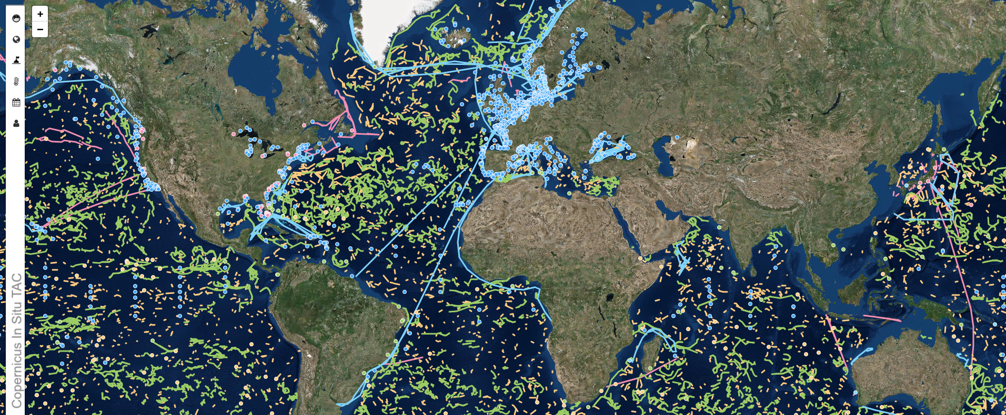
In Situ Products
5. CMEMS In Situ TAC Improvements Dashboard
> Services > Dashboard http://www.marineinsitu.eu/dashboard/
CMEMS IBI TRAINING WORKSHOP, In Situ Products, 14-15 May, Lisbon, Portugal

Slide 30
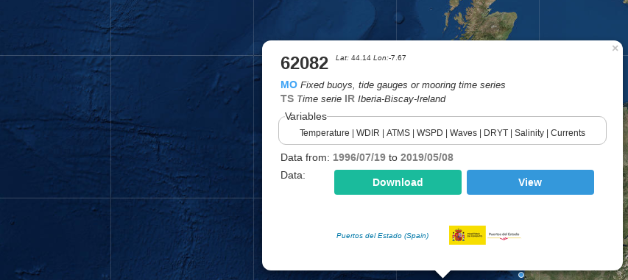
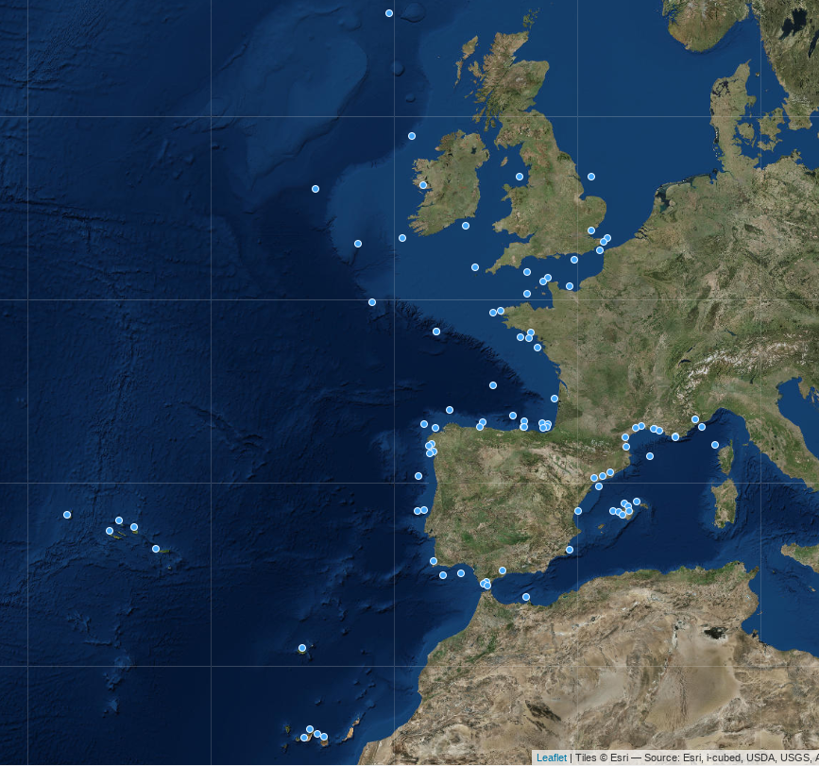
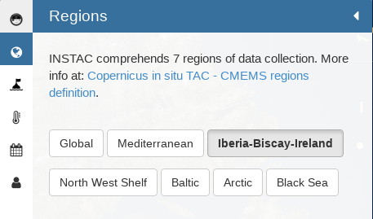
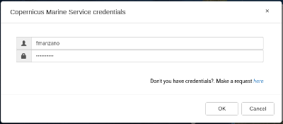
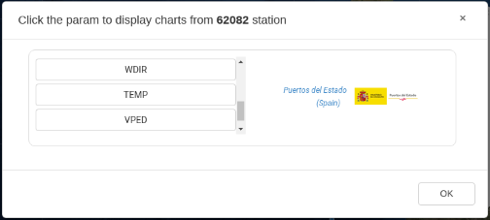
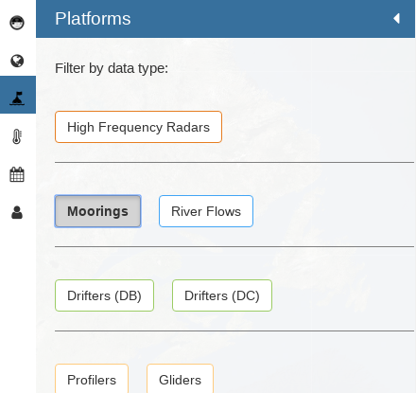
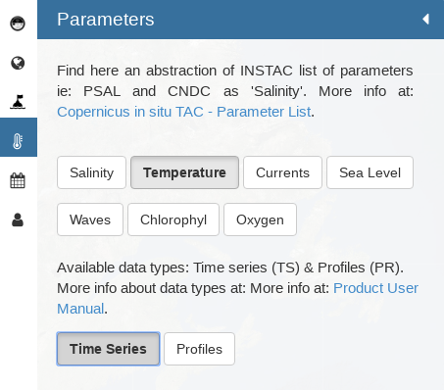
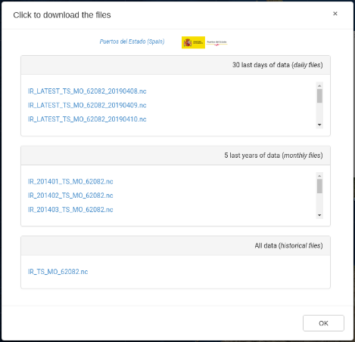
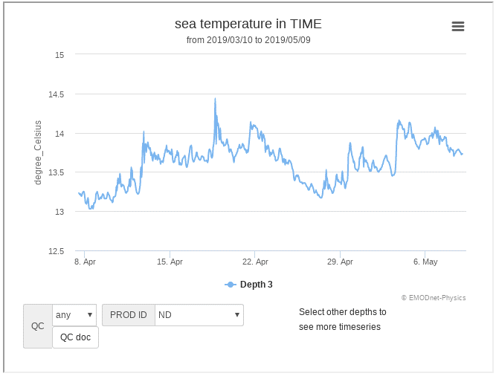
In Situ Products
5. CMEMS In Situ TAC Improvements Dashboard
> Services > Dashboard http://www.marineinsitu.eu/dashboard/
CMEMS IBI TRAINING WORKSHOP, In Situ Products, 14-15 May, Lisbon, Portugal

Slide 31
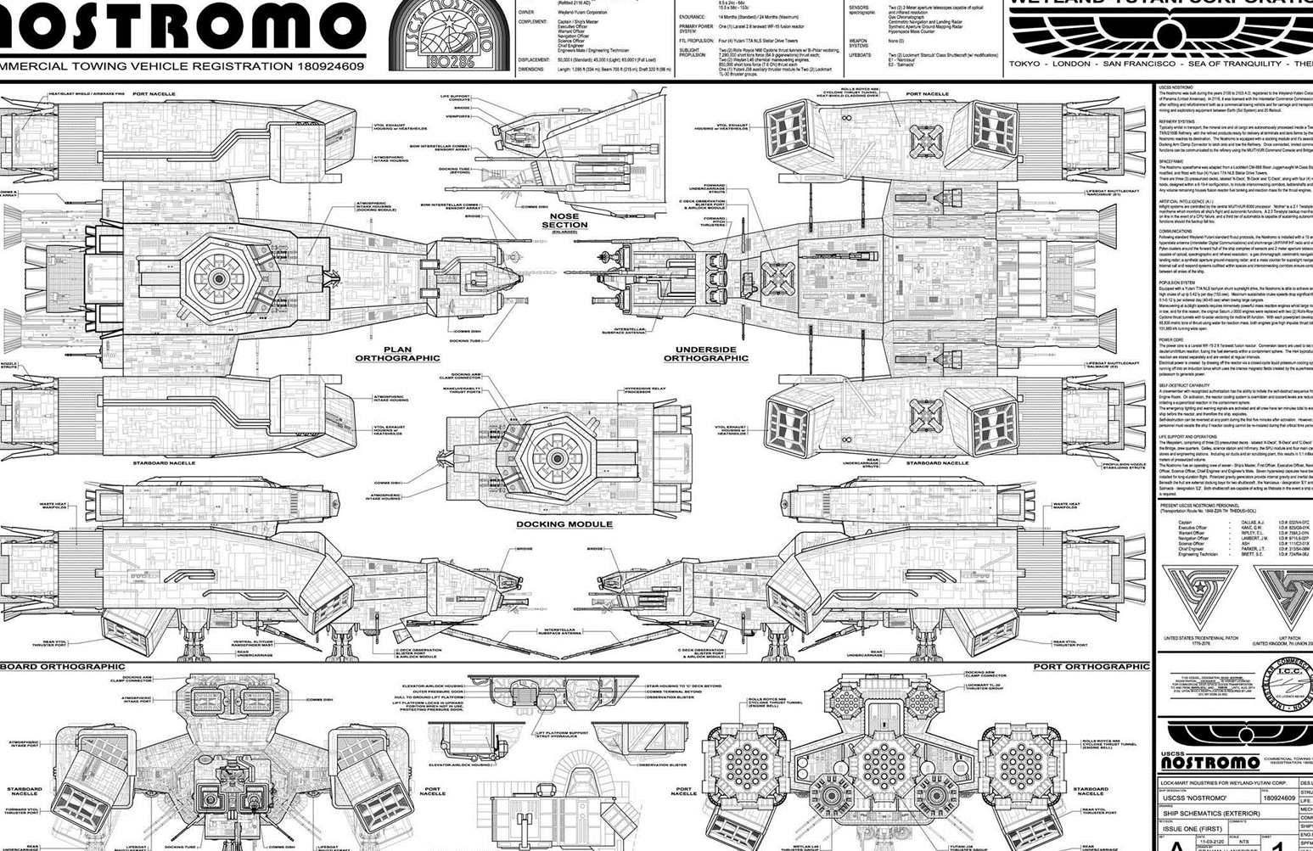
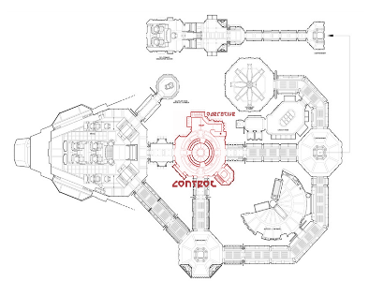
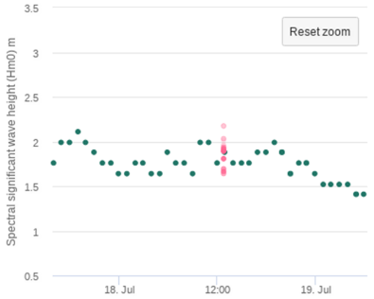
In Situ Products
6. Upgrades, better products
Strengthening of the operative
Improving the data quality
NOSTROMO
IBISVAL

Slide 32


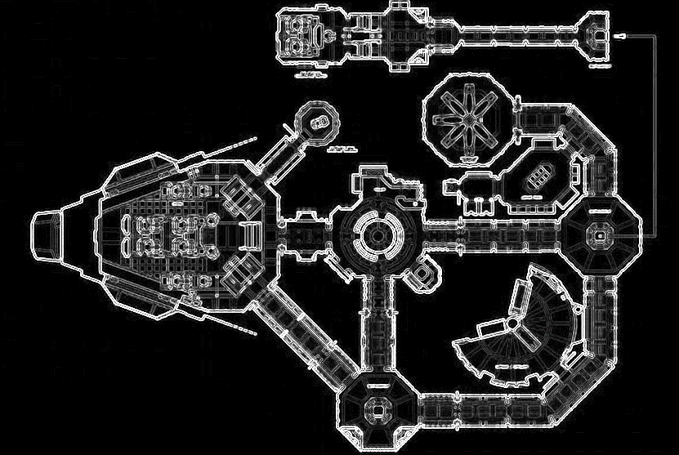

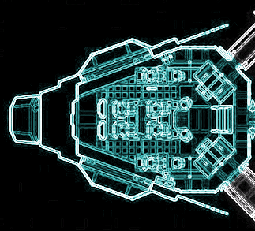

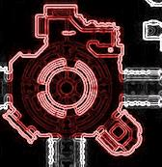
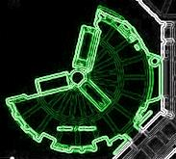

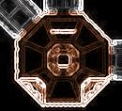
In Situ Products
6. Upgrades, better products NOSTROMO
For internal use only
NOSTROMO: Integrated system to monitor and control de IBI CMEMS In Situ TAC operative.
CMEMS IBI TRAINING WORKSHOP, In Situ Products, 14-15 May, Lisbon, Portugal

Slide 33
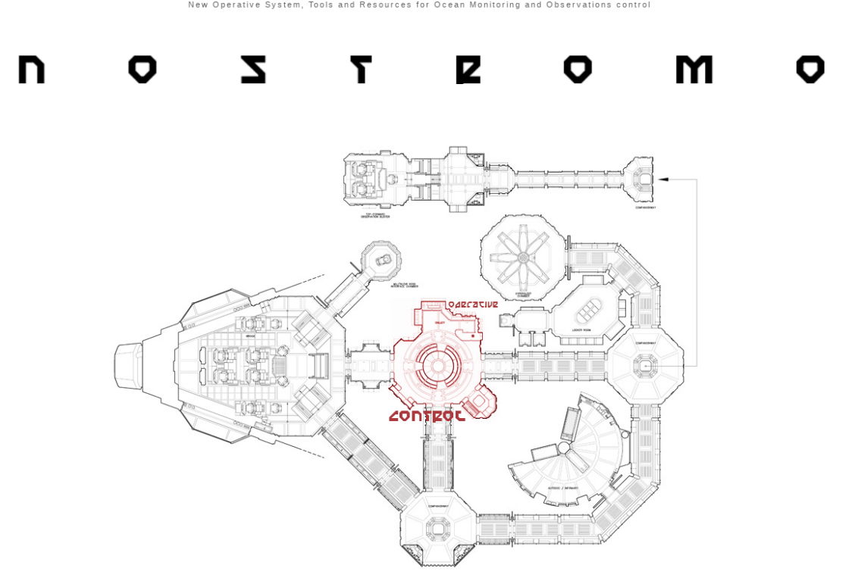




In Situ Products
6. Upgrades, better products NOSTROMO
CONTROL: Manual and customized launching of the procedures.
CMEMS IBI TRAINING WORKSHOP, In Situ Products, 14-15 May, Lisbon, Portugal

Slide 34


In Situ Products
6. Upgrades, better products NOSTROMO
DATA BASE VIEWER: Visualization of data series. It allows to modify flags in the database
CMEMS IBI TRAINING WORKSHOP, In Situ Products, 14-15 May, Lisbon, Portugal

Slide 35



In Situ Products
6. Upgrades, better products NOSTROMO
CENTRAL DU: Checks the status of the files in the Central DU.
CMEMS IBI TRAINING WORKSHOP, In Situ Products, 14-15 May, Lisbon, Portugal

Slide 36


In Situ Products
6. Upgrades, better products NOSTROMO
NETCDF VIEWER: Visualization of data series from the NetCDF files.
CMEMS IBI TRAINING WORKSHOP, In Situ Products, 14-15 May, Lisbon, Portugal

Slide 37



In Situ Products
6. Upgrades, better products NOSTROMO
MONITORING: Errors and alerts visualization system.
CMEMS IBI TRAINING WORKSHOP, In Situ Products, 14-15 May, Lisbon, Portugal

Slide 38

In Situ Products
6. Upgrades, better products NOSTROMO
IBISVAL: IBI Software for Validation.
CMEMS IBI TRAINING WORKSHOP, In Situ Products, 14-15 May, Lisbon, Portugal

Slide 39








In Situ Products
6. Upgrades, better products IBISVAL
CMEMS IBI TRAINING WORKSHOP, In Situ Products, 14-15 May, Lisbon, Portugal
39

Slide 40



Thank you!
Fernando Manzano
fmanzano@puertos.es
fernando.manzano@nologin.es

